Slide 1
Web Science:
Searching the Web
(Part 1 - Crawling the Web)
CS 432/532
Old Dominion University
Permission has been granted to use these slides from Frank McCown, Michael L. Nelson, Alexander Nwala, Michele C. Weigle
This work is licensed under a Creative Commons Attribution-NonCommercial-ShareAlike 3.0 Unported License

Slide 2
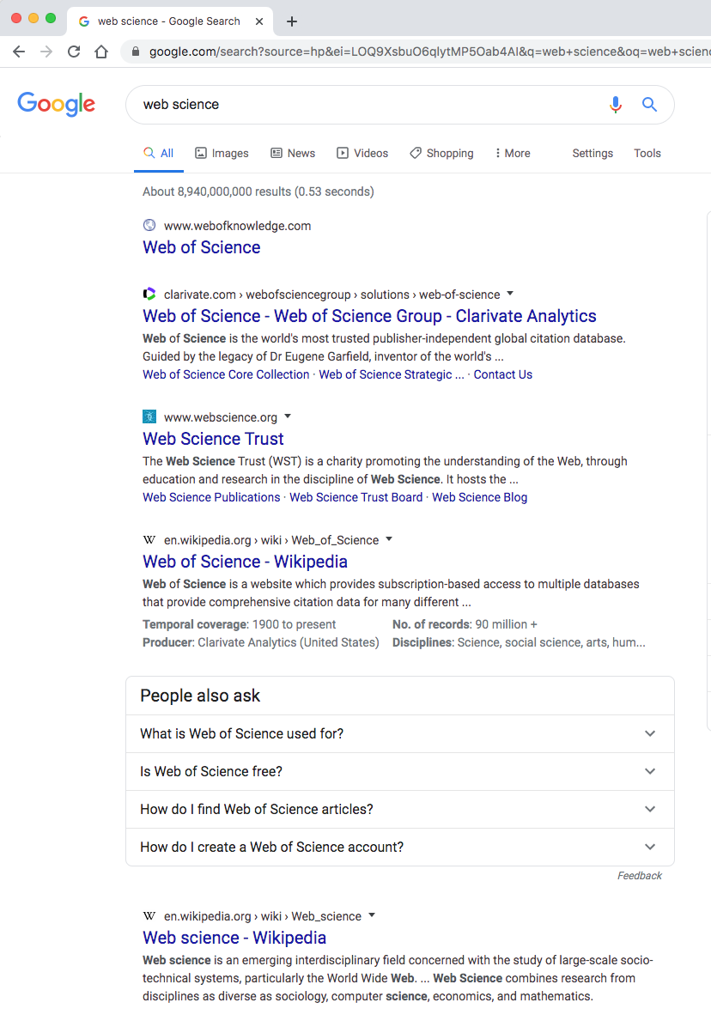
Search for “web science”

Slide 3
Overview of Web Search
Must collect the documents
crawl the web
Then index the documents
what words are in each document?
Finally, return a ranked list of documents from a query
ranking is where the hard part comes in

Slide 4
What we'll examine
Web crawling
Building an index
Querying the index
Term frequency and inverse document frequency
Other methods to increase relevance
How links between web pages can be used to improve ranking search engine results
Link spam and how to overcome it

Slide 5
Web Crawling
Large search engines use thousands of continually running web crawlers to discover web content
Web crawlers fetch a page, place all the page's links in a queue, fetch the next link from the queue, and repeat
Web crawlers are usually polite
Identify themselves through the HTTP User-Agent request header (e.g., googlebot)
Throttle requests to a web server, crawl at off-peak times
Honor robots exclusion protocol (robots.txt). Example: User-agent: * Disallow: /private
more about robots.txt: The Web Robots Pages

Slide 6
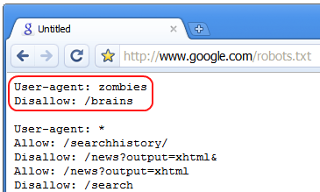
Robots.txt Humor
Halloween 2008
"Halloween easter egg: Google protects itself from zombies", which links to live version of robots.txt (archived version of robots.txt)

Slide 7
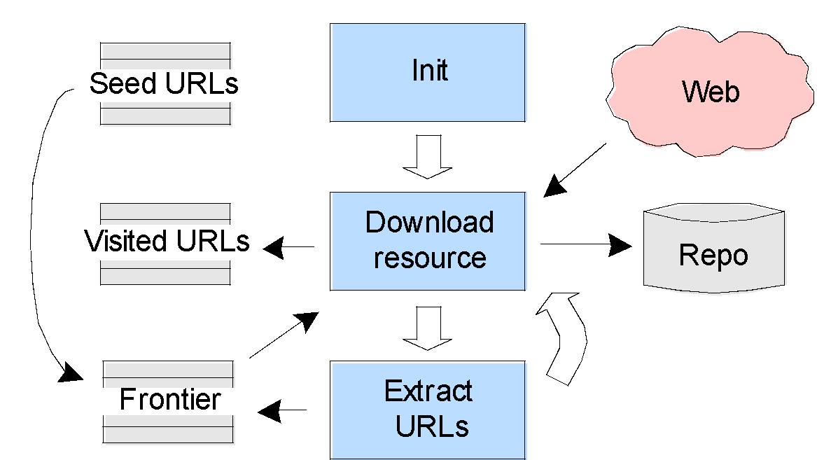
Web Crawler Components
Figure: McCown, Lazy Preservation: Reconstructing Websites from the Web Infrastructure, Dissertation, 2007

Slide 8
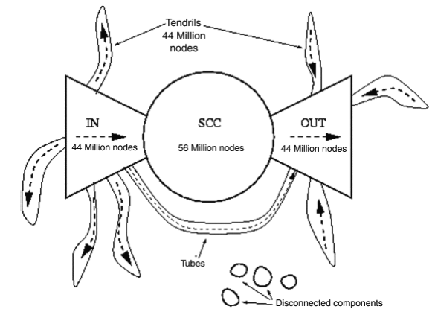
Crawling Issues
Good source for seed URLs:
DMOZ - The Directory of the Web
archived version of dmoz.org
Previously crawled URLs
Search engine competing goals:
Keep index fresh (crawl often)
Comprehensive index (crawl as much as possible)
Which URLs should be visited first or more often?
Breadth-first (FIFO)
Pages which change frequently & significantly
Popular or highly-linked pages
remember the bow-tie?

Slide 9
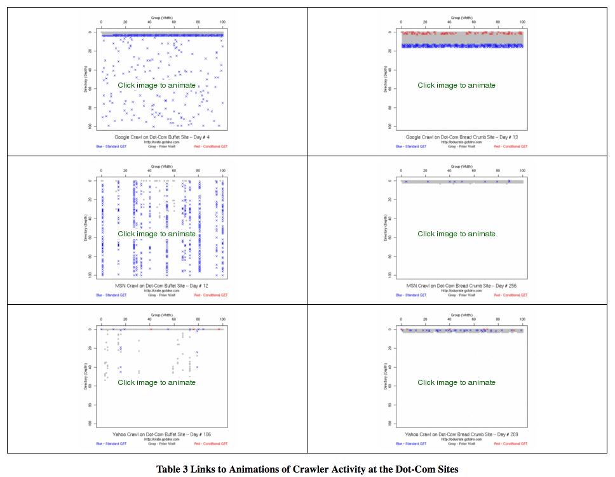
web crawler animations - see Table 3 of Smith and Nelson, Site Design Impact on Robots: An Examination of Search Engine Crawler Behavior at Deep and Wide Websites, 2008

Slide 10
Crawling Issues - Part 2
Should avoid crawling duplicate content
Convert page content to compact string (fingerprint) and compare to previously crawled fingerprints
Should avoid crawling spam
Content analysis of page could make crawler ignore it while crawling or in post-crawl processing
Robot traps
Deliberate or accidental trail of infinite links (e.g., calendar)
Solution: limit depth of crawl
Deep Web
Throw search terms at interface to discover pages¹
Sitemaps allow websites to publish URLs that might not be discovered in regular web crawling
¹Madhavan et al., Google's Deep Web crawl, Proc. VLDB 2008

Slide 11
Example Sitemap
<?xml version="1.0" encoding="UTF-8"?> <urlset xmlns="http://www.sitemaps.org/schemas/sitemap/0.9"> <url> <loc>http://www.example.com/</loc> <lastmod>2009-10-22</lastmod> <changefreq>weekly</changefreq> <priority>0.8</priority> </url>
<url> <loc>http://www.example.com/specials.html</loc> <changefreq>daily</changefreq> <priority>0.9</priority> </url> <url> <loc>http://www.example.com/about.html</loc>
<lastmod>2009-11-4</lastmod> <changefreq>monthly</changefreq> </url> </urlset>

Slide 12
Find Sitemaps in robots.txt
$ curl -i www.cnn.com/robots.txt
HTTP/1.1 200 OK
Date: Wed, 05 Feb 2020 20:29:35 GMT
Content-Type: text/plain; charset=utf-8
Content-Length: 1061
Accept-Ranges: bytes
Date: Wed, 05 Feb 2020 20:29:35 GMT
Transfer-Encoding: chunked
Connection: keep-alive
Sitemap: https://www.cnn.com/sitemaps/cnn/index.xml
Sitemap: https://www.cnn.com/sitemaps/cnn/news.xml
Sitemap: https://www.cnn.com/sitemaps/sitemap-section.xml
Sitemap: https://www.cnn.com/sitemaps/sitemap-interactive.xml
Sitemap: https://www.cnn.com/ampstories/sitemap.xml
Sitemap: https://edition.cnn.com/sitemaps/news.xml
User-agent: *
Allow: /audio/podcasts/
Allow: /partners/ipad/live-video.json
Disallow: /*.jsx$
Disallow: /ads/
Disallow: /aol/
[deletia…]

Slide 13
Focused Crawling
A vertical search engine focuses on a subset of the Web
Google Scholar – scholarly literature
Shopzilla – Internet shopping
A topical, or focused, web crawler attempts to download only pages about a specific topic
Has to analyze page content to determine if it's on topic and if links should be followed
Usually analyzes anchor text as well

Slide 14
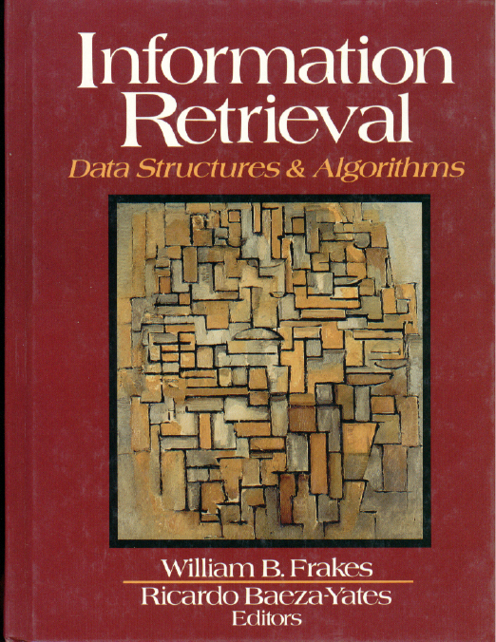
Is What I've Found On Topic?
Precision
"ratio of the number of relevant documents retrieved over the total number of documents retrieved" (p. 10)
how much extra stuff did you get?
Recall
"ratio of relevant documents retrieved for a given query over the number of relevant documents for that query in the database" (p. 10)
note: assumes a priori knowledge of the denominator!
how much did you miss?
[FBY]

Slide 15
Precision and Recall
1
Precision
Figure 1.2
in FBY
0
1
Recall

Slide 16
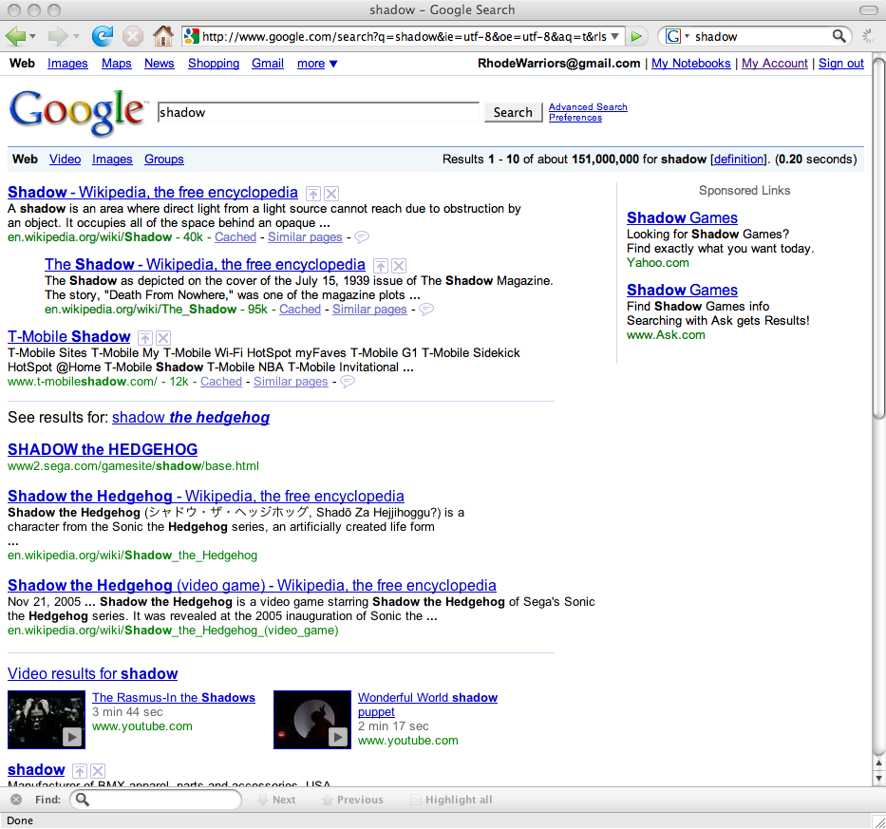
Why Isn't Precision Always 100%?
What were we really searching for?
Science? Games? Music?

Slide 17
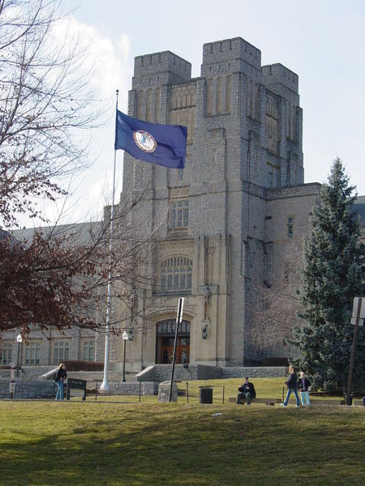
Why Isn't Recall Always 100%?
Virginia Agricultural and Mechanical College?
Virginia Agricultural and Mechanical College
and Polytechnic Institute?
Virginia Polytechnic Institute?
Virginia Polytechnic Institute
and State University?
Virginia Tech?

Slide 18

Precision and Recall in Diagrams
From: Precision and recall (Wikipedia)

Slide 19
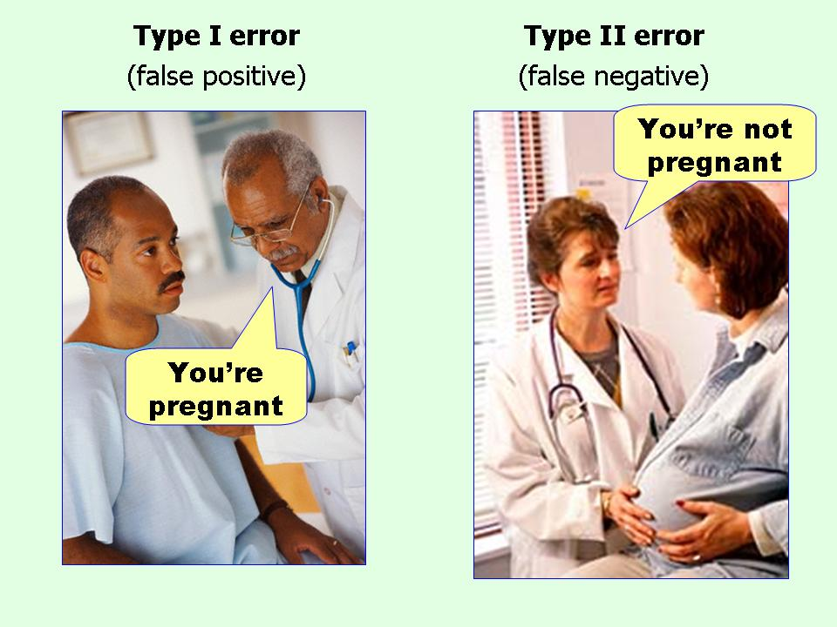
Mnemonic for I vs. II
From: Posted in Type II error

Slide 20
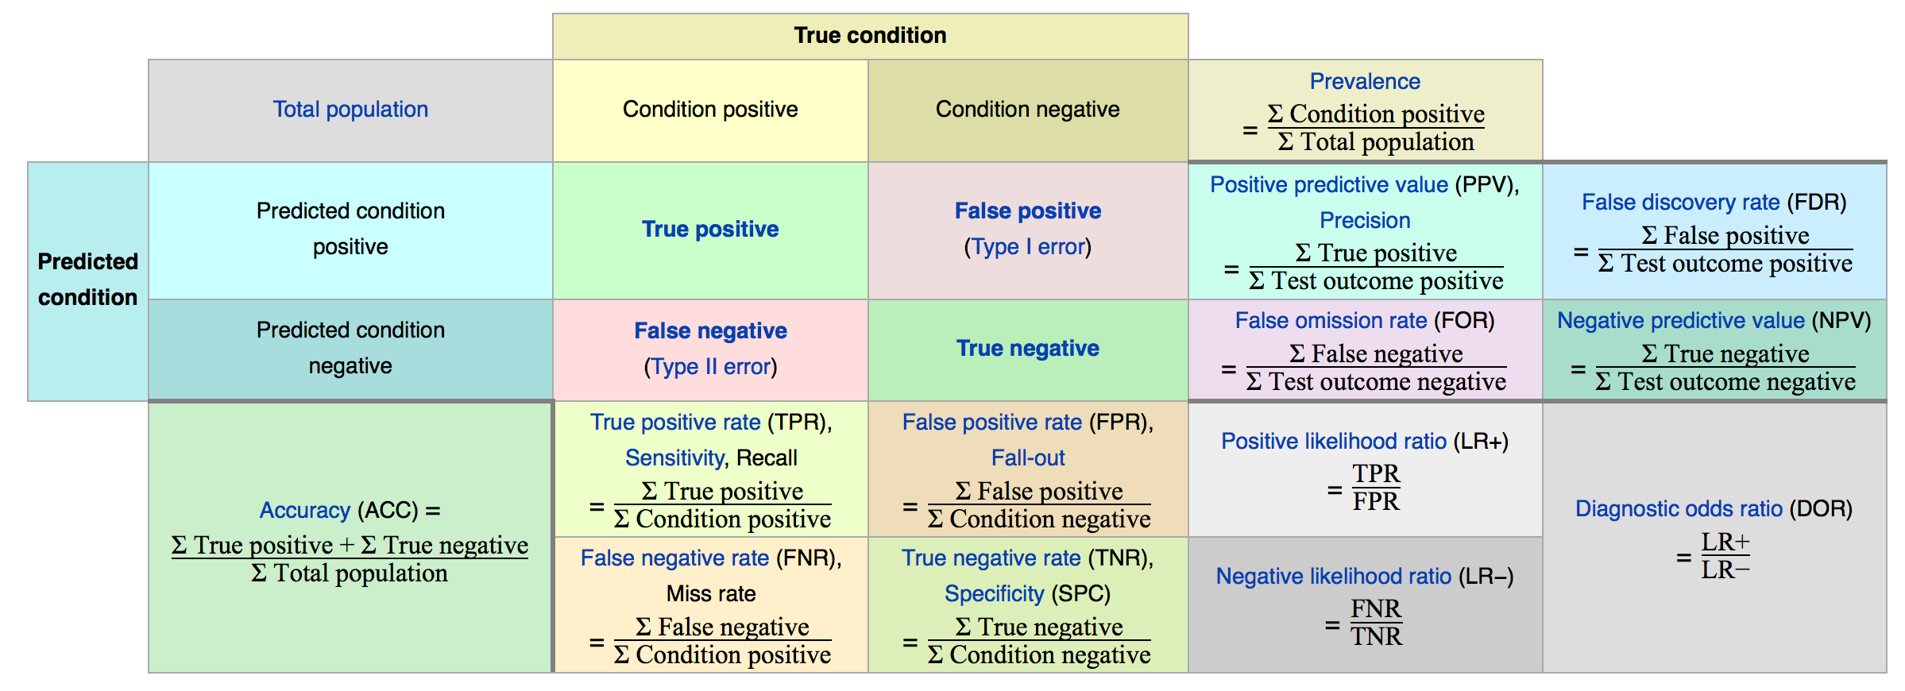
More than just P&R…
From: Precision and recall (Wikipedia)

Slide 21
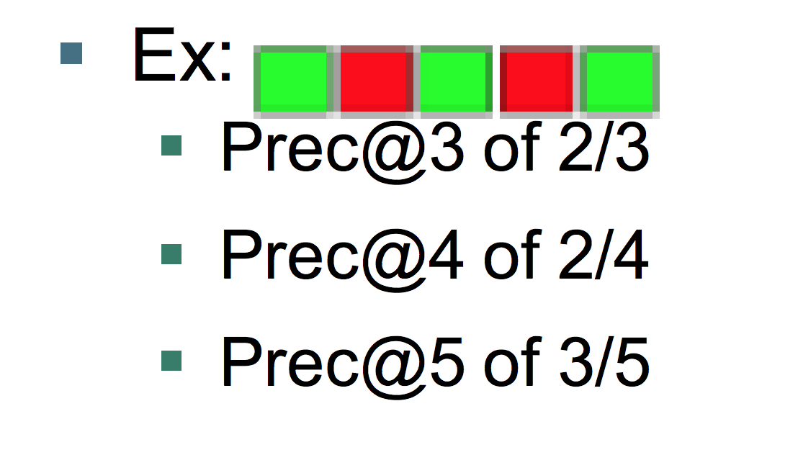
Adapting Precision & Recall for Web Scale
Precision @ n (often n=10)
previous query for shadow had ~151M hits!
no one will check more than just a few
"ten blue links”
10 blue links: are they dead or alive in search? – Econsultancy
Relative recall
recall was hard enough on bounded collections; all but impossible for Web
relative recall is a way of judging SE overlap
(recall of system A) / (recall of A + B … + N)

Slide 22
Web Science:
Searching the Web
(Part 2 - Indexing the Documents)
CS 432/532
Old Dominion University
Permission has been granted to use these slides from Frank McCown, Michael L. Nelson, Alexander Nwala, Michele C. Weigle
This work is licensed under a Creative Commons Attribution-NonCommercial-ShareAlike 3.0 Unported License

Slide 23
Processing Pages
After crawling, content is indexed and links stored in link database for later analysis
Text from text-based files (HTML, PDF, MS Word, etc.) are converted into tokens
Stop words may be removed
Frequently occurring words like a, the, and, to, etc.
Stop word (Wikipedia)
Most traditional IR systems remove them, but most search engines do not ("to be or not to be")
Special rules to handle punctuation
e-mail → email?
Treat "O'Connor" like "boy's"?
123-4567 as one token or two?

Slide 24
Processing Pages
Stemming may be applied to tokens
Technique to remove suffixes from words (e.g., gamer, gaming, games → gam)
Porter Stemmer very popular algorithmic stemmer
Can reduce size of index and improve recall, but precision is often reduced
Google and Yahoo use partial stemming
Tokens may be converted to lowercase
Most web search engines are case insensitive

Slide 25
Inverted Index
Inverted index, or inverted file, is the data structure used to hold tokens and the pages they are located in
Example:
Doc 1: It is what it was.
Doc 2: What is it?
Doc 3: It is a banana.
documents
it
is
what
was
a
banana
1, 2, 3
1, 2, 3
1, 2
1
3
3
term list

Slide 26
Example Search
Search for what is it is interpreted by search engines as what AND is AND it
what: {1, 2} is: {1, 2, 3} it: {1, 2, 3}
{1, 2} ∩ {1, 2, 3} ∩ {1, 2, 3} = {1, 2}
Answer: Docs 1 and 2
What if we want the phrase "what is it"?
it
is
what
was
a
banana
1, 2, 3
1, 2, 3
1, 2
1
3
3

Slide 27
Phrase Search
Phrase search requires position of words to be added to inverted index
Doc 1: It is what it was.
Doc 2: What is it?
Doc 3: It is a banana.
it
is
what
was
a
banana
(1,1) (1,4) (2,3) (3,1)
(1,2) (2,2) (3,2)
(1,3) (2,1)
(1,5)
(3,3)
(3,4)

Slide 28
Example Phrase Search
Search for "what is it"
All items must be in same doc with position in increasing order
what: (1,3) (2,1) is: (1,2) (2,2) (3,2) it: (1,1) (1,4) (2,3) (3,1)
Answer: Document 2
Position can be used to give higher scores to terms that are closer
"red cars" scores higher than "red bright cars"

Slide 29
What About Large Indexes?
When indexing the entire Web, the inverted index will be too large for a single computer
Solution: Break up index onto separate machines/clusters
Two general methods:
Document-based partitioning
Term-based partitioning

Slide 30
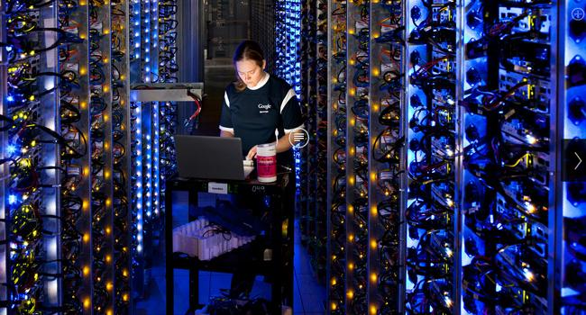
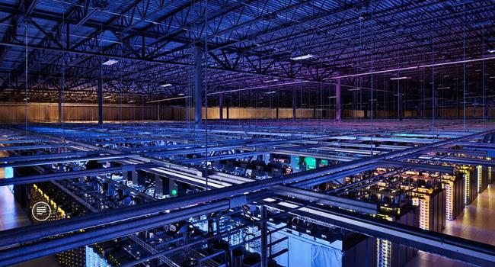
Google's Data Centers
Image source: 10 of the coolest photos from inside Google's secret data centres

Slide 31
Partitioning Schemes
Document-based Partitioning
apple
banana
apple
banana
1, 10
2
3, 5
3, 5
apple
banana
…
1, 3, 5,10
2, 3, 5
Term-based Partitioning
apple
banana
1, 3, 5, 10
2, 3, 5
apple
banana
…
1, 3, 5,10
2, 3, 5
Ref: Distributing indexes, Introduction to Information Retrieval

Slide 32
Comparing the Two Schemes
Event | Document-Based | Term-Based
Fetch query results | All computers fetch local results and merge | Single machine fetches result for each term
Machine goes down | Some docs not in results | Some terms cannot be processed
Index new doc | Add new terms/docs to single machine | Rebuild index
Guess which scheme Google uses?

Slide 33
Web Science:
Searching the Web
(Part 3 - Ranking: TF-IDF)
CS 432/532
Old Dominion University
Permission has been granted to use these slides from Frank McCown, Michael L. Nelson, Alexander Nwala, Michele C. Weigle
This work is licensed under a Creative Commons Attribution-NonCommercial-ShareAlike 3.0 Unported License

Slide 34

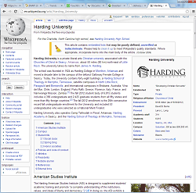
If two documents contain the same query terms, how do we determine which one is more relevant?
?

Slide 35
Term Frequency
Query for "dogs" results in two pages:
Dogs, dogs, I love them dogs!
Dogs are wonderful animals.
TF = 3
TF = 1
Doc A
Doc B
Which page should be ranked higher?
Simple method called term frequency: Count number of times the term occurs in the document
Pages with higher TF get ranked higher

Slide 36
Normalizing Term Frequency
Query for "dogs" results in two pages:
Dogs, dogs, I love them dogs!
Dogs are wonderful animals.
TF = 3/6 = 0.5
TF = 1/4 = 0.25
Doc A
Doc B
To avoid penalizing shorter documents, TF should be normalized
Divide by total number of words in the document
Other divisors possible

Slide 37
TF Can Be Spammed!
Watch out!
TF is susceptible to spamming, so SEs look for unusually high TF values when looking for spam
Dogs, dogs, I love them dogs!
dogs
dogs
dogs
dogs
dogs
TF = 8/11 = 0.72

Slide 38
Inverse Document Frequency
Problem: Some terms are frequently used throughout the corpus and therefore aren't useful when discriminating docs from each other
Less frequently used terms are more helpful
IDF(term) = total docs in corpus / docs with term
Low frequency terms will have high IDF

Slide 39
Inverse Document Frequency
To keep IDF from growing too large as corpus grows: IDF(term) = log₂(total docs in corpus / docs with term)
IDF is not as easy to spam since it involves all docs in corpus
Could stuff rare words in your pages to raise IDF for those terms, but people don't often search for rare terms

Slide 40
TF-IDF
TF and IDF are usually combined into a single score
TF-IDF = TF × IDF = occurrence in doc / words in doc × log₂(total docs in corpus / docs with term)
When computing TF-IDF score of a doc for n terms:
Score = TF-IDF(term₁) + TF-IDF(term₂) + … + TF-IDF(term_{n})

Slide 41
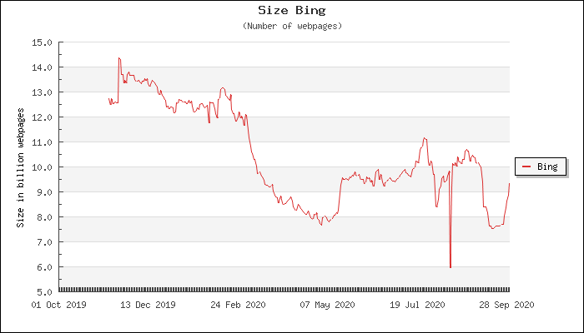
TF-IDF Example
Using Bing, compute the TF-IDF scores for 2 documents that contain the words harding AND university
Assume Bing has 10 billion documents indexed
WorldWideWebSize.com (accessed Sep 2020)

Slide 42
TF-IDF Example
Actions to perform:
Query Bing with harding university to pick 2 docs
Query Bing with just harding to determine how many docs contain harding
Query Bing with just university to determine how many docs contain university

Slide 43
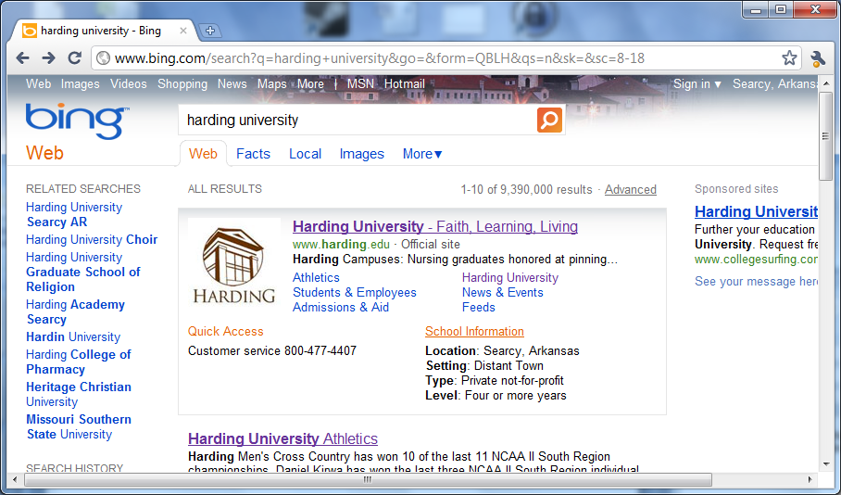
1) Search for harding university and choose two results

Slide 44
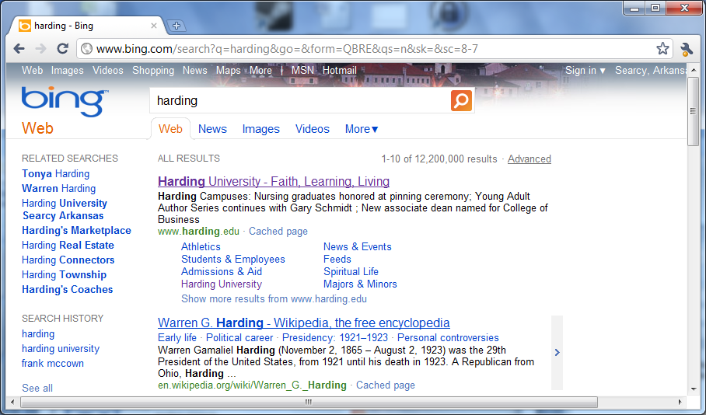
2) Search for harding
Gross exaggeration

Slide 45
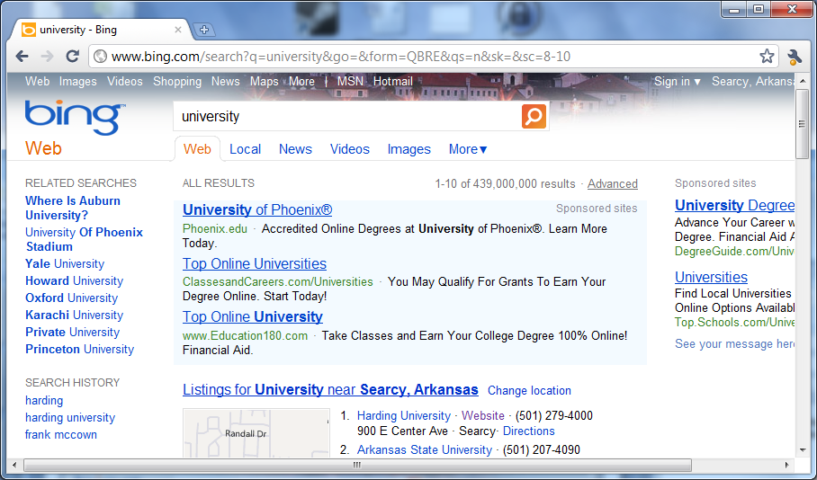
2) Search for university

Slide 46
Doc 1: Harding - College of Pharmacy
webpage contains 967 words
"harding" appears 19 times
"university" appears 13 times
TF(harding) = 19 / 967
IDF(harding) = log₂(10B / 12.2M)
TF(university) = 13 / 967
IDF(university) = log₂(10B / 439M)
Assume Bing has 10 billion documents indexed

Slide 47
Doc 1: Harding - College of Pharmacy
TF(harding) = 19 / 967 = 0.020
IDF(harding) = log₂(10B / 12.2M) = 9.679
TF(university) = 13 / 967 = 0.013
IDF(university) = log₂(10B / 439M) = 4.510
TF-IDF(harding) + TF-IDF(university) = 0.020 × 9.679 + 0.013 × 4.510 = 0.252
log₂ x is log(x,2) in R

Slide 48
Doc 2: Harding University (Wikipedia)
webpage contains 3135 words
"harding" appears 44 times
"university" appears 25 times
TF(harding) = 44 / 3135
IDF(harding) = log₂(10B / 12.2M)
TF(university) = 25 / 3135
IDF(university) = log₂(10B / 439M)
Assume Bing has 10 billion documents indexed

Slide 49
Doc 2: Harding University (Wikipedia)
TF(harding) = 44 / 3135 = 0.014
IDF(harding) = log₂(10B / 12.2M) = 9.679
TF(university) = 25 / 3135 = 0.008
IDF(university) = log₂(10B / 439M) = 4.510
TF-IDF(harding) + TF-IDF(university) = 0.014 × 9.679 + 0.008 × 4.510 = 0.172
Doc 1 = 0.252
Doc 2 = 0.172

Slide 50
Web Science:
Searching the Web
(Part 4 - Ranking: Link-based Metrics, PageRank, and HITS)
CS 432/532
Old Dominion University
Permission has been granted to use these slides from Frank McCown, Michael L. Nelson, Alexander Nwala, Michele C. Weigle
This work is licensed under a Creative Commons Attribution-NonCommercial-ShareAlike 3.0 Unported License

Slide 51
Increasing Relevance
Index words in URL
Weigh importance of terms based on HTML or CSS styles
Website responsiveness¹
Account for last modification date
Allow for misspellings
Link-based metrics
Popularity-based metrics
¹Using site speed in web search ranking

Slide 52
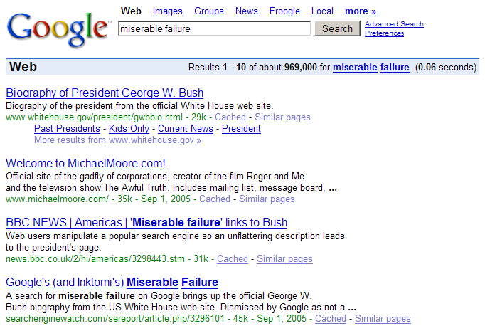
Increasing Relevance
Index a link's anchor text along with the page it points to
<a href="skill.html">Ninja skills</a>
Watch out: Google bombs (Google bombing (Wikipedia))
More info: Google Kills Bush's Miserable Failure Search & Other Google Bombs

Slide 53
Increasing Relevance
Index words in URL
Weigh importance of terms based on HTML or CSS styles
Website responsiveness¹
Account for last modification date
Allow for misspellings
Link-based metrics
Popularity-based metrics
¹Using site speed in web search ranking

Slide 54
Link Analysis
Content analysis is useful, but combining with link analysis allow us to rank pages much more successfully
2 popular methods
Sergey Brin and Larry Page's PageRank
Jon Kleinberg's Hyperlink-Induced Topic Search (HITS)

Slide 55
What Does a Link Mean?
A
B
A recommends B
A specifically does not recommend B
B is an authoritative reference for something in A
A & B are about the same thing (topic locality)

Slide 56
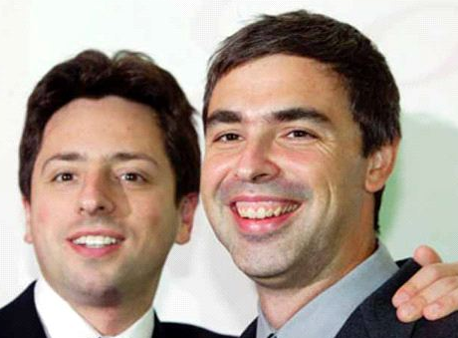
PageRank
Developed by Brin and Page (Google) while Ph.D. students at Stanford
Links are a recommendation system
The more links that point to you, the more important you are
Inlinks from important pages are weightier than inlinks from unimportant pages
The more outlinks you have, the less weight your links carry
Page et al., The PageRank citation ranking: Bringing order to the web, 1998.
Image credit: http://scrapetv.com/News/News%20Pages/Technology/images/sergey-brin-larry-page.jpg

Slide 57
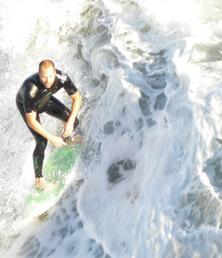
Random Surfer Model
Model helpful for understanding PageRank
The Random Surfer starts at a randomly chosen page and selects a link at random to follow
PageRank of a page reflects the probability that the surfer lands on that page after clicking any number of links
Image credit: http://missloki84.deviantart.com/art/Random-Surfer-at-Huntington-Beach-319287873

Slide 58
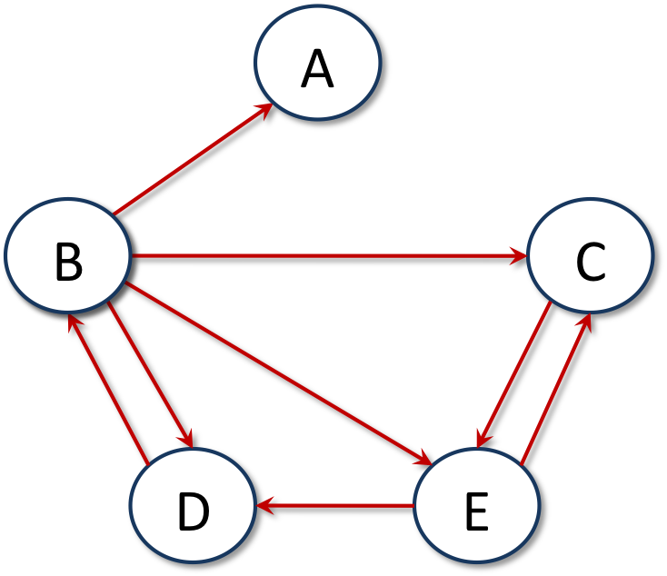
Example of Random Surfer
Start at: B
¼ probability of going to A
¼ probability of going to C
¼ probability of going to D
¼ probability of going to E
Choose: E
½ probability of going to C ½ probability of going to D

Slide 59
Problem 1: Dangling Node
What if we go to A? We're stuck at a dead-end!
Solution: Teleport to any other page at random

Slide 60
Problem 2: Infinite Loop
What if we get stuck in an a cycle?
Solution: Teleport to any other page at random
A
X
Y

Slide 61
Rank Sinks
Dangling nodes and cycles are called rank sinks
Solution is to add a teleportation probability α to every decision
α% chance of getting bored and jumping somewhere else, (1-α)% chance of choosing one of the available links
α = 0.15 is typical

Slide 62
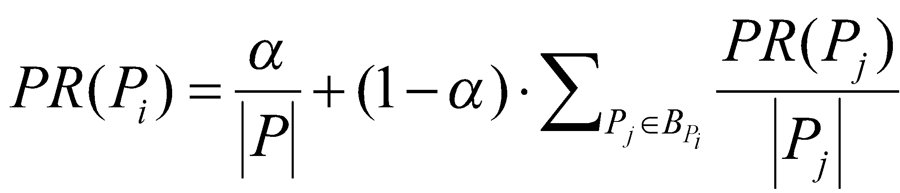
PageRank Definition
Teleportation probability
Sum of PR of all pages pointing to P_{i}
PageRank of page P_{i}
Total num of pages
Number of outlinks from P_{j}
B_{Pi} is set of all pages pointing to P_{i}

Slide 63

PageRank Example
PR(C) = .15/5 + .85 × (PR(B)/4 + PR(E)/2)
Problem: What is PR(B) and PR(E)?
Solution: Give all pages same PR to start (1/|P|) & iteratively calculate new PR

Slide 64
PageRank Example
PR(A) = .03 + .85 × PR(B)/4
= .03 + .85 x .2/4 = .0725
PR(B) = .03 + . 85 × PR(D)/1
= .03 + .85 x .2/1 = .2
PR(C) = .03 + .85(PR(B)/4 + PR(E)/2)
= .03 + .85(.2/4 + .2/2) = .1575
PR(D) = .03 + .85(PR(B)/4 + PR(E)/2) = .1575 PR(E) = .03 + .85(PR(B)/4 + PR(C)/1) = .2425
α/|P| = .15 / 5 = .03
initial PR = 1/|P|= 1/5 = .2

Slide 65
Calculating PageRank
PageRank is computed over and over until it converges, around 20 times
Can also be calculated efficiently using matrix multiplication
we'll see this a little later

Slide 66
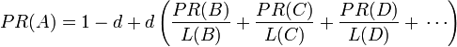
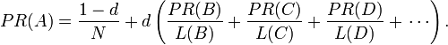
Computing PageRank
original paper version, sums to N (number of
pages in graph)
more common version, sums to 1
d = damping factor
L() = out-degree of a page
PR() = PageRank of a page (all nodes start with PR() = 1 or 1/N)

Slide 67

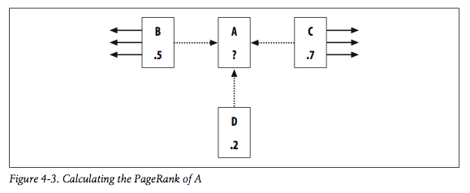
Calculating PageRank for a Page, One Iteration
Ref: Programming Collective Intelligence, Ch 4
Fig 4-3 needs an
extra link from C
to match the text
PR(A) = (1-0.85) + 0.85 * (PR(B)/links(B) + PR(C)/links(C) + PR(D)/links(D))
= 0.15 + 0.85 * (0.5/4 + 0.7/5 + 0.2/1)
= 0.15 + 0.85 * (0.125 + 0.14 + 0.2)
= 0.15 + 0.85 * 0.465
= 0.54525
damping factor (d) = 0.85 (probability surfer landed on page by following a link)
1-d = 0.15 (probability surfer landed on page at “random”)
since this is the original version where PR sums to N, and we've only accounted for ~1.95 of total PR, pages not shown must be holding PR

Slide 68

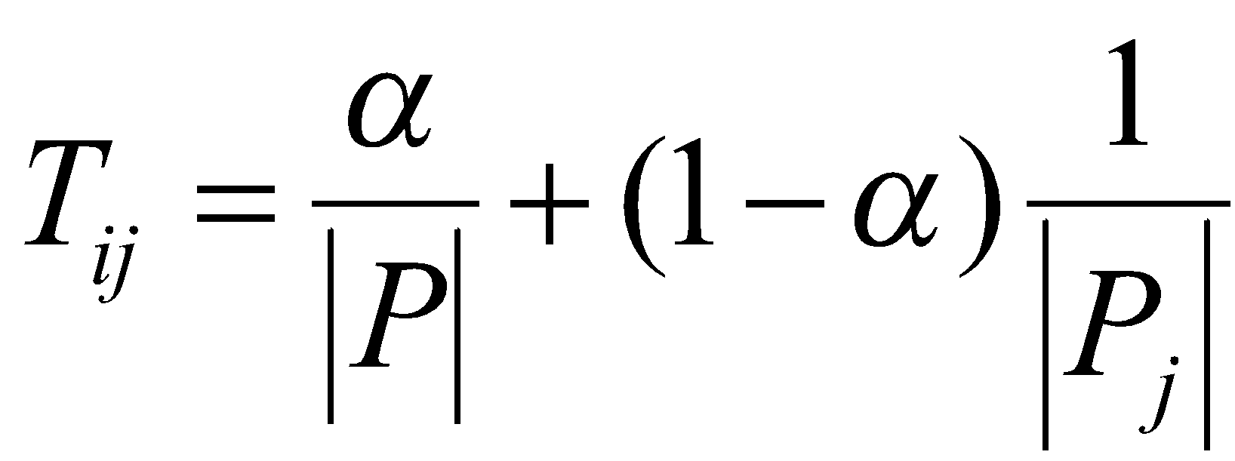
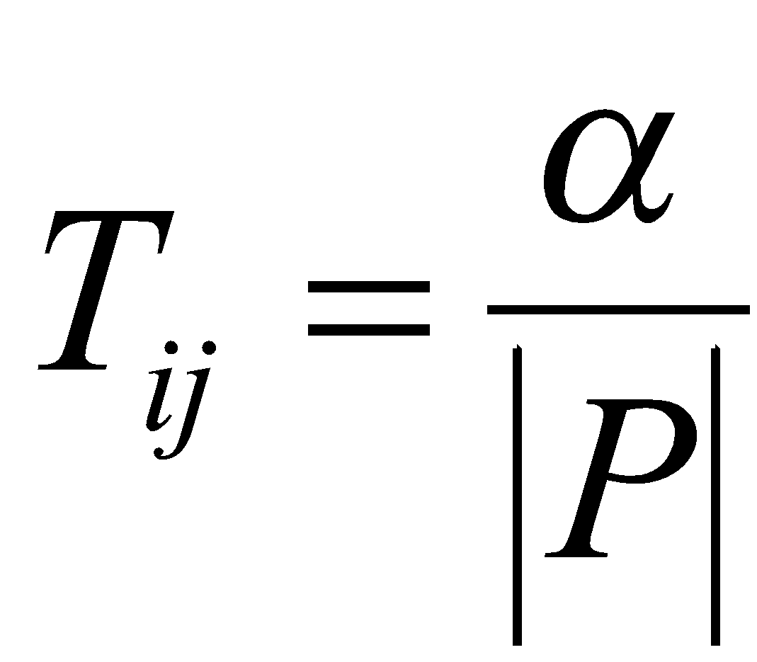
PageRank Definition as Matrix
Stated as a matrix equation where R is the vector of PageRank values and T the matrix for transition probabilities:
where T_{ij} is the probability of going from page j to i:
if a link from page j to i
exists, otherwise
Total num of pages
Total outlinks from page j

Slide 69
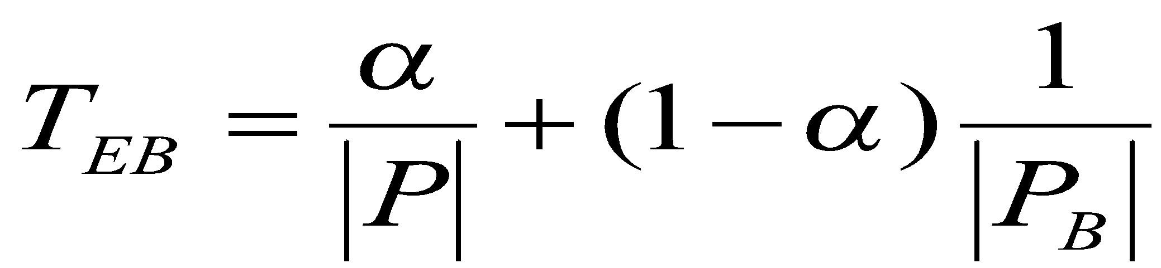
PageRank Matrix Example
No link from C to A, so value = .15/5
PR_{A}
PR_{B}
PR_{C}
PR_{D}
PR_{E}
. . .03 . .
. . . . .
. . . . .
. . . . .
. .243 . . .
.2
.2
.2
.2
.2
=
Init PR values
1/|P|
= .15/5 + (1 – .15)/4 = .243

Slide 70
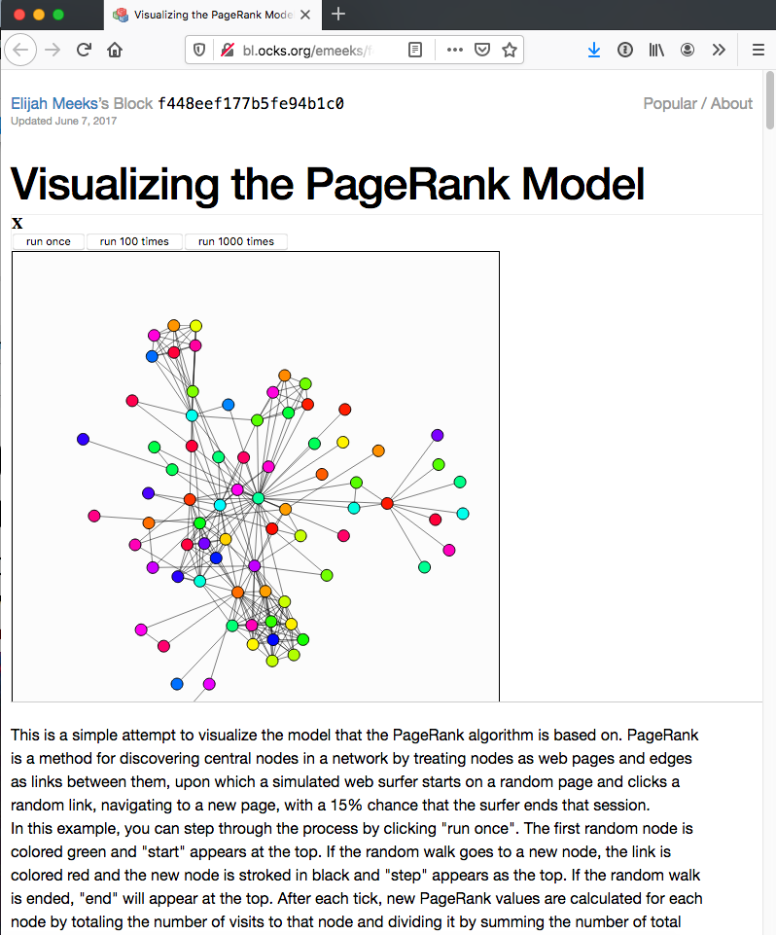
Visualizing the PageRank Model

Slide 71
Check Your PageRank…
Check Google page rank instantly
9/10: google.com, cnn.com
7/10: www.cs.odu.edu
5/10: ws-dl.blogspot.com
2/10: lsufootball.net
updated Feb 2020

Slide 72
PageRank Issues
Rich-get-richer phenomenon
May be difficult for new pages with few inlinks to compete with older, highly linked pages with high PageRank
Could promote small fraction of new pages at random¹ or add decay factor to links
Study² showed just counting number of inlinks gives similar ranking as PageRank
Study was on small scale and pages were not necessarily "typical"
Counting inlinks more susceptible to spamming
¹Pandey et al., Shuffling a stacked deck, VLDB 2005,
²Amento et al., Does "authority" mean quality?, SIGIR 2000

Slide 73
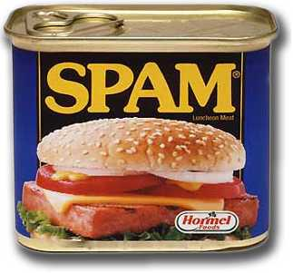
Link Spam
There is a strong economic incentive to rank highly in a SERP
“White hat” SEO firms follow published guidelines to improve customer rankings¹
To boost PageRank, “black hat” SEO practices include:
Building elaborate link farms
Exchanging reciprocal links
Posting links on blogs and forums
¹Google's Webmaster Guidelines

Slide 74
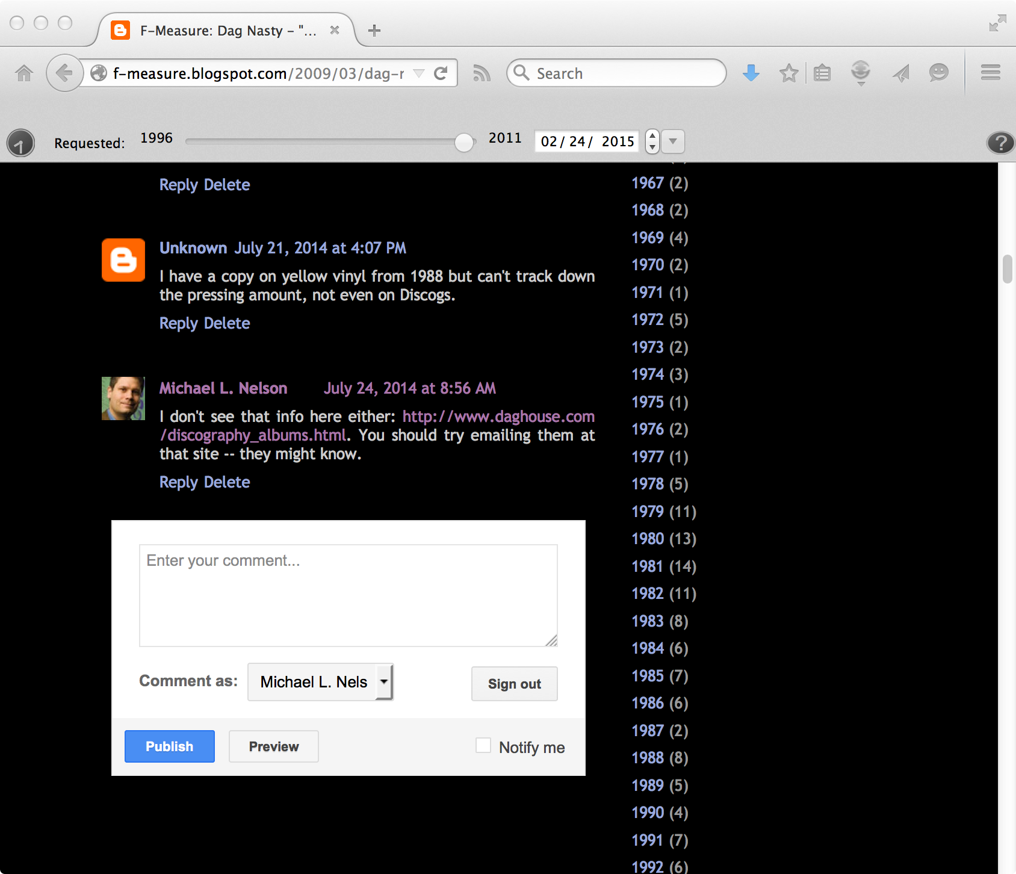
Trying to Stealing PageRank…
…I don’t see that info here either:
<a href="http://www.daghouse.com/discography_albums.html"
rel="nofollow">http://www.daghouse.com/discography_albums.html</a>.
You should try emailing them at that site…
nofollow (Wikipedia) / Comment spam (Wikipedia)
Dag Nasty - "Wig Out at Denko's" (forgotten song) (the song remains the same)

Slide 75
Combating Link Spam
Sites like Wikipedia can discourage links that only promote PageRank by using "nofollow"
<a href="http://somesite.com/" rel="nofollow">Go here!</a>
Davison¹ identified 75 features for comparing source and destination pages
Overlap, identical page titles, same links, etc.
TrustRank²
Bias teleportation in PageRank to set of trusted web pages
¹Davison, Recognizing nepotistic links on the web, 2000
²Gyöngyi et al., Combating web spam with TrustRank, VLDB 2004

Slide 76
Combating Link Spam
SpamRank¹
PageRank for whole Web has power-law distribution
Penalize pages whose supporting pages do not approximate power-law distribution
Anti-TrustRank²
Give high weight to known spam pages and propagate values using PageRank
New pages can be classified spam if large contribution of PageRank from known spam pages, or if high Anti-TrustRank
¹Benczúr et al., SpamRank – fully automated link spam detection, AIRWeb 2005
²Krishnan & Raj, Web spam detection with Anti-TrustRank, AIRWeb 2006

Slide 77
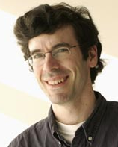
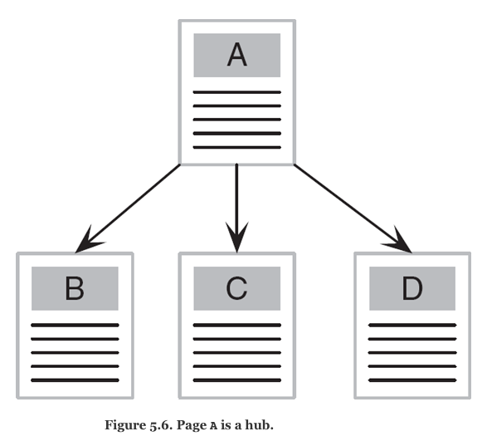
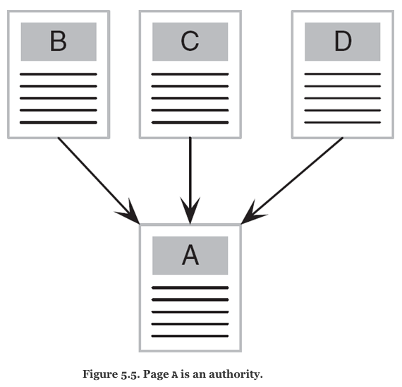
HITS
Hyperlink-induced topic search (HITS) by Jon Kleinberg¹
Hub: page with outlinks to informative web pages
Authority: informative/authoritative page with many inlinks
Recursive definition:
Good hubs point to good authorities
Good authorities are pointed to by good hubs
Img credit: http://scgp.stonybrook.edu/archives/6084
Figures from Levene (2010), An Introduction to Search Engines and Web Page Navigation
¹Kleinberg, Authoritative sources in a hyperlinked environment, J. ACM, 1999

Slide 78
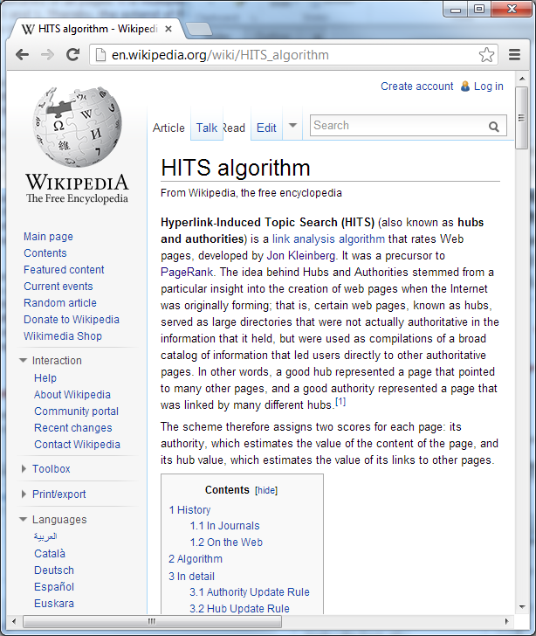
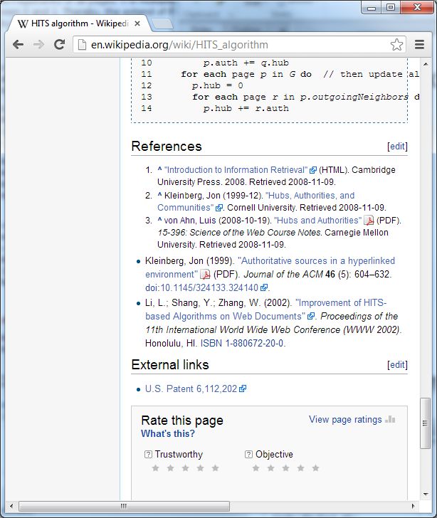
Good Authority & Hub?

Slide 79
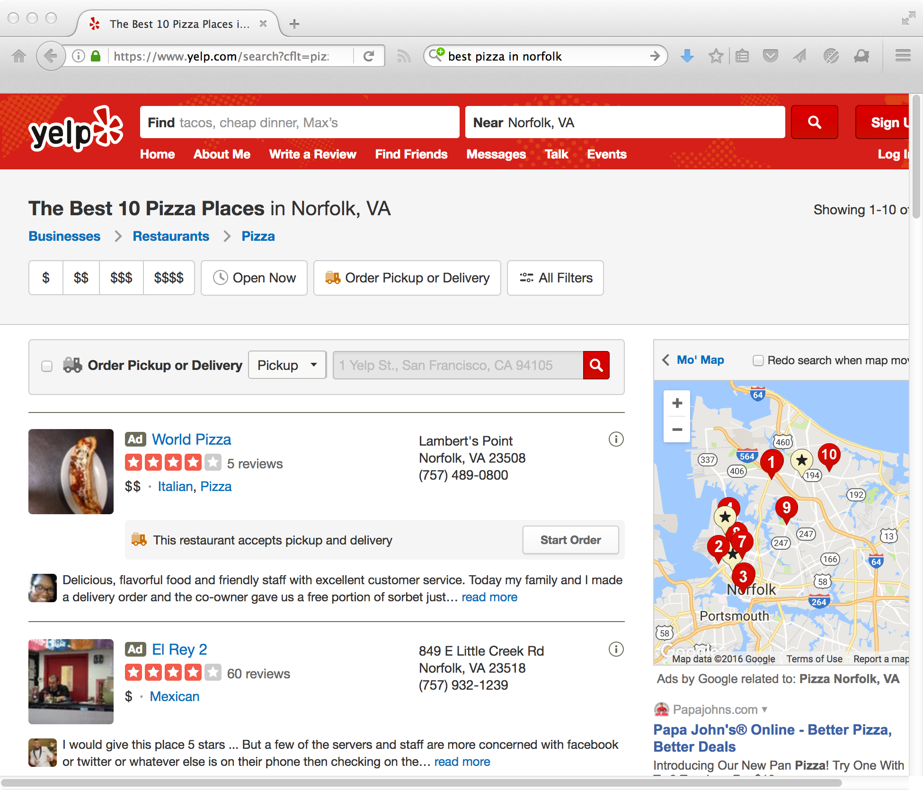
A Good Hub

Slide 80
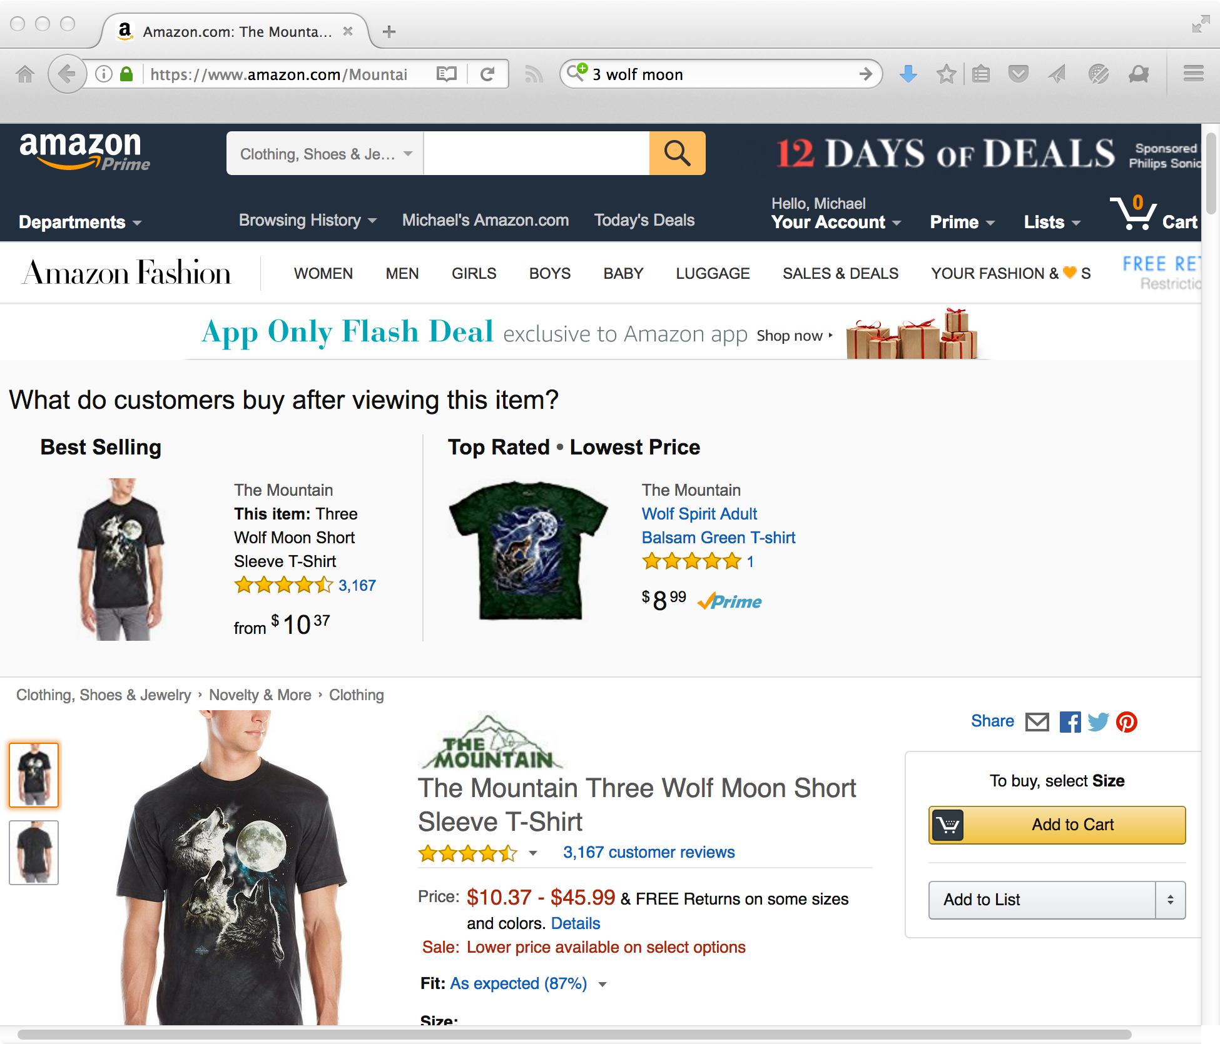
A Good Authority

Slide 81
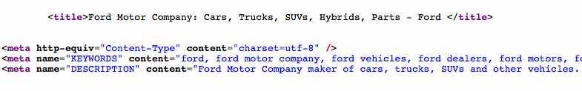
In the Bad Old Days, Discovery Was Difficult…
ford.com, toyota.com, etc. don't describe themselves as "automobile manufacturers", though a query for those terms arguably should return those companies
harvard.edu is clearly canonical for a query of "Harvard", even though it uses the term less frequently than many other pages
Many search engines of the day (ca. late 90s) could not "find themselves"

Slide 82
HITS Algorithm
Retrieve pages most relevant to search query¹ → root set
Retrieve all pages linked to/from the root set → base set
Perform authority and hub calculations iteratively on all nodes in the subgraph
When finished, every node has an authority score and hub score
¹ note: you apply HITS to other search engines
Levene (2010), An Introduction to Search Engines and Web Page Navigation

Slide 83
Idea: Use Initial Search Results as "Root"
include pages that link to the root
include pages the root links to
root
base
now you have a subgraph to work with

Slide 84
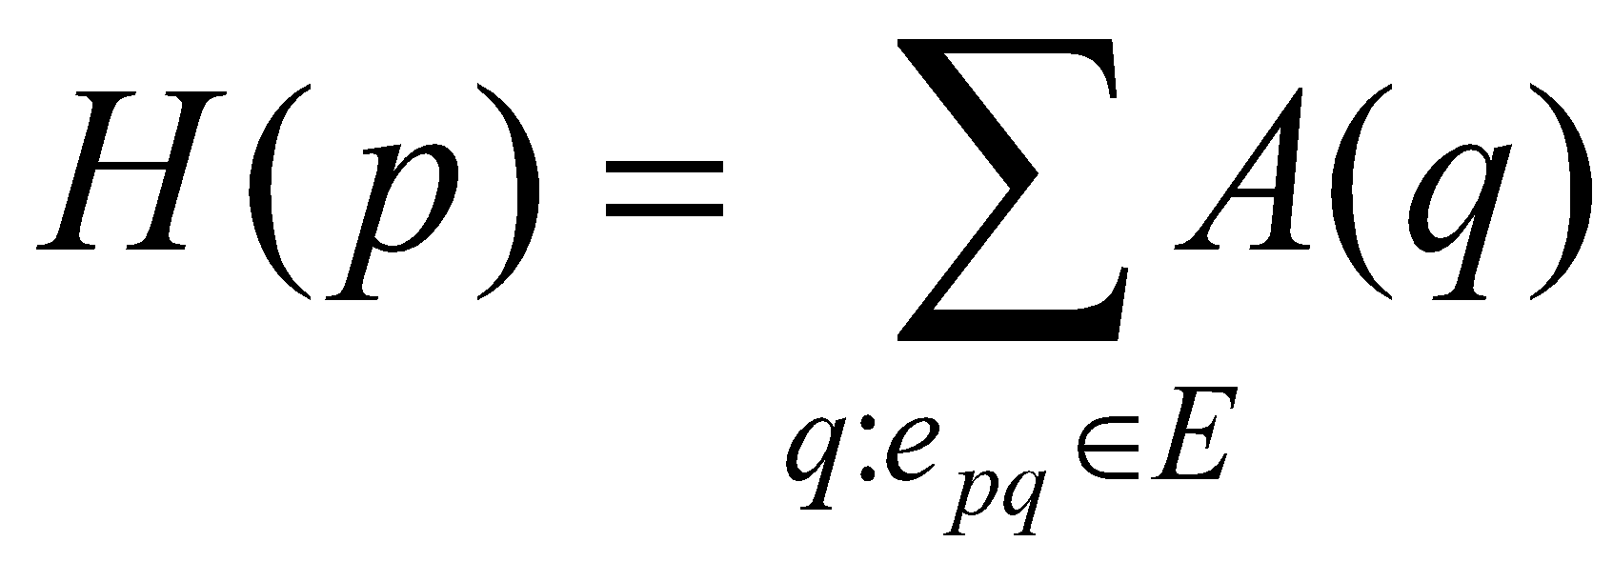
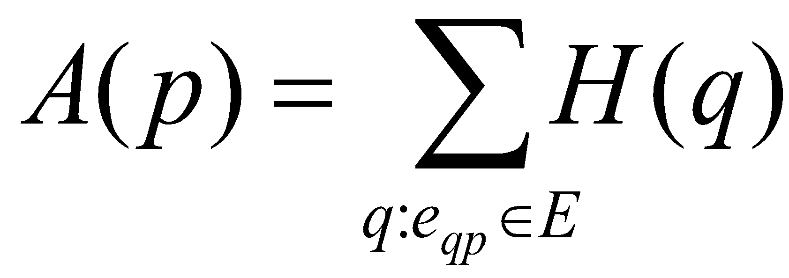
Calculate H and A
E is set of all directed edges in subgraph
e_{qp} is edge from page q to p
H and A scores computed repetitively until they converge, about 10-15 iterations
Can also be calculated efficiently using matrix multiplication
outlinks
inlinks

Slide 85
Example Subgraph
A B C D
A
B
0 1 1 0
1 0 1 0
0 1 0 1
0 1 0 0
A
B
C
D
C
D
Adjacency matrix

Slide 86
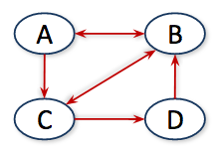
Authority Scores
Best authority
A_{A}
A_{B}
A_{C}
A_{D}
0 1 0 0
1 0 1 1
1 1 0 0
0 0 1 0
1
1
1
1
1
3
2
1
=
x
=
Transposed adjacency matrix
Authority scores
Initial hub scores
Resulting
auth scores

Slide 87
Hub Scores
Best hub
H_{A}
H_{B}
H_{C}
H_{D}
0 1 1 0
1 0 1 0
0 1 0 1
0 1 0 0
1
3
2
1
5
3
4
3
=
x
=
Hub scores
Adjacency matrix
Init auth scores
Resulting
hub scores

Slide 88
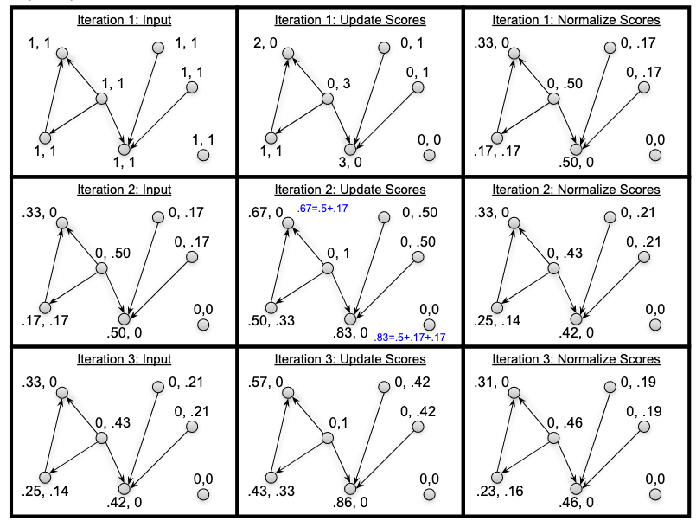
HITS Example
Fig 10.3 from Search Engines: Information Retrieval in Practice
(Authority, Hub)

Slide 89
Problems with HITS
Has not been widely used
IBM holds patent
Query dependence
Later implementations have made query independent
Topic drift
Pages in expanded base set may not be on same topic as root pages
Solution is to examine link text when expanding
Levene (2010), An Introduction to Search Engines and Web Page Navigation

Slide 90
Objectives
Describe the main steps needed for web search.
Describe what a web crawler does.
Explain the difference between precision and recall.
Explain the difference between false positives and false negatives.
Explain TF-IDF and how it is used to determine relevance in web search.
Explain the importance of inlinks and outlinks in the Page Rank algorithm.
Given a query term, compute TF-IDF for the term in a set of documents.

